Slide 1
Procedural Generated Maze Game Application
By Joshua Phillips
For Coder Academy 2023 Term 1 Assignment 3

Slide 2
Features
Generation of ASCII maze: main feature of application
Single Maze gaming mode: terminal play of generated maze
Setting Maze wall colour: customisation of maze colour
Output Maze to .txt file: save a maze in plain text file for offline play/printing

Slide 3
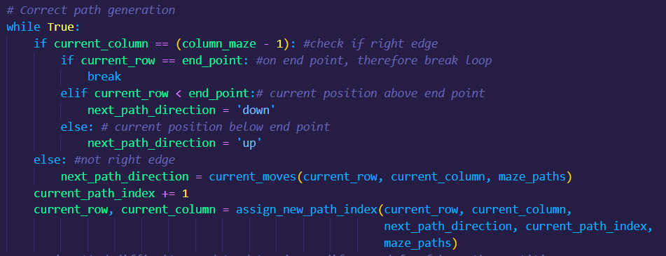
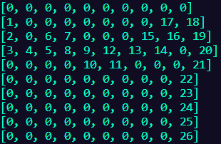
Features: Generation of ASCII maze
maze_generator.py
Correct path generated

Slide 4
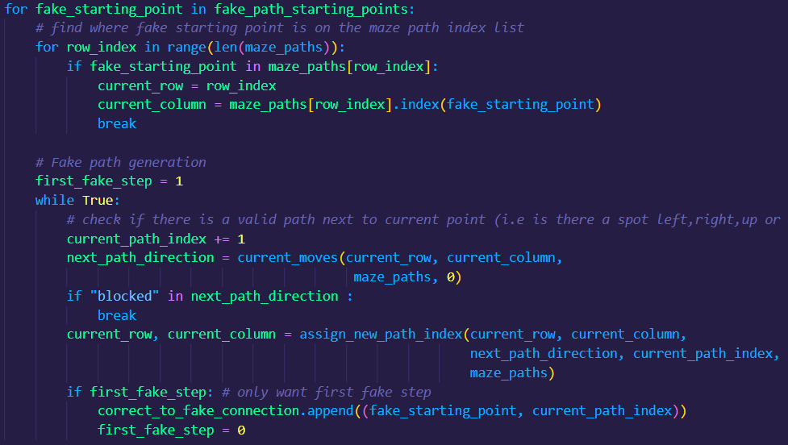
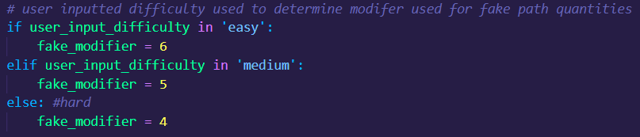
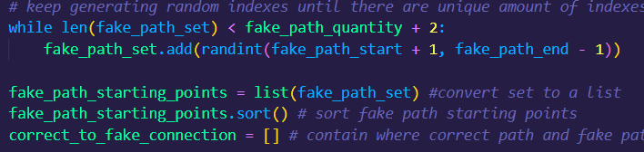
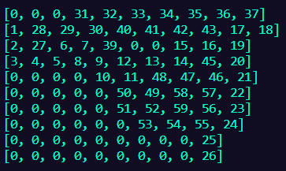
Features: Generation of ASCII maze
maze_generator.py
Correct path generated
Fake paths generated around correct path

Slide 5
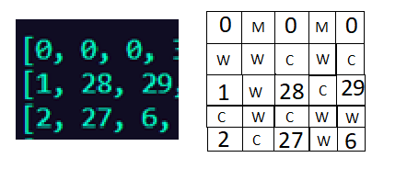
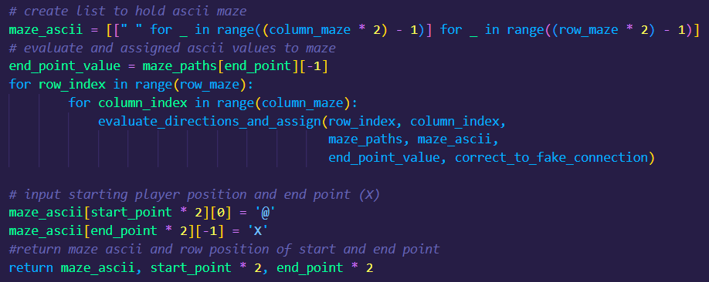
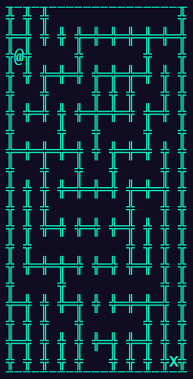
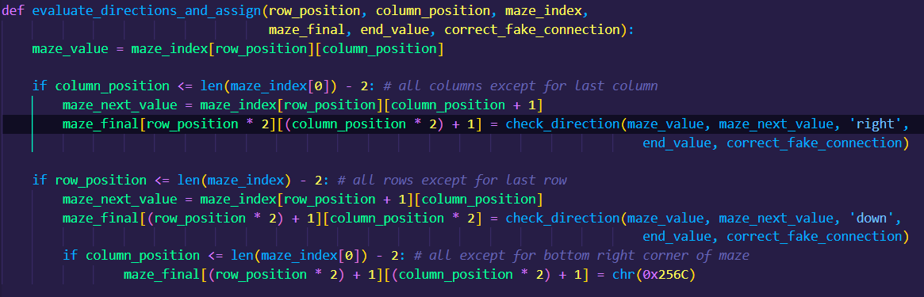
Features: Generation of ASCII maze
maze_generator.py

